Slide 1
Stock Assessments in Support of U.S. Fisheries
Richard D. Methot
NOAA Senior Scientist for Stock Assessments
Seattle, WA
Patrick D. Lynch
Fishery Biologist
NOAA Fisheries
Silver Spring, MD

Slide 2
Presentation Outline
Mandate for Assessments
Supporting Fishery Management Plans
Data Requirements
Assessment Modeling
Fishery Control Rules
Stock Assessment: Collecting, analyzing, and reporting demographic information for the purpose of determining the effects of fishing on fish populations
Notes:
Control rules to implement ACL requirements

Slide 3
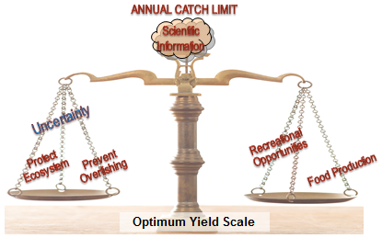
MSFCMA: National Standards 1, 2, 3
NS1: “Conservation and management measures shall prevent overfishing while achieving, on a continuing basis, the optimum yield from each fishery for the United States fishing industry.”
NS2: “Conservation and management measures shall be based upon the best scientific information available.”
NS3: “…an individual stock of fish shall be managed as a unit throughout its range….”
Notes:
Dual mandate with Act: harvest the optimum yield while preventing overfishing

Slide 4
Fishery Management Plans
Establish a mechanism for specifying annual catch limits … at a level such that overfishing does not occur in the fishery, including measures to ensure accountability.
Specify objective and measurable criteria for identifying when the fishery … is overfished
Related to reproductive potential of stock
Annual Catch Limits (ACLs) may not exceed Council’s Scientific and Statistical Committee’s fishing level recommendation
Based on best scientific information available
Notes:
Unlike MMPA, which has a strict requirement for stock assessments, MSA does not specify that assessments are required, but collectively these statements imply that stock assessments are necessary

Slide 5
Stock Assessment / Council Process
Draft
Assessment
Product
(NMFS science
with partners)
Public
Peer-Review
(with external, independent
and regional scientists,
some from SSC and Plan Team)
Benchmark
Routine Update
Plan Team
(State, NMFS)
Implementation Plan
Scientific & Statistical Committee
(academic, State, NMFS scientists)
PRODUCT: Science Advice,
Fishing Level Recommendation
Fishery
Management
Council
Industry/Public
Advisory Panel
Secretarial
Approval,
Implementation
By NMFS
Recommended Annual Catch Limit
http://www.nrc.noaa.gov
Notes:
NMFS stock assessment efforts are conducted in partnership with State, Commission and academic scientists and the assessment results are publically vetted through the Fishery Management Council process
Details of how this flow works differ somewhat between regions.
The overall process is a partnership: data – analysis – review – recommendations – implementation
Plan teams: groups of mostly scientists (and managers) that help develop management operations (allocations)…formal groups established in Council process
Plan teams and advisory panels can interpret SSC advice

Slide 6
Assessment Jargon
Stock; Population
Biological unit being analyzed, and its fishery
Abundance; Biomass (B)
how many fish out there; total weight of the stock
Reproductive potential; Spawning biomass (B, SB, SPB)
Produce 1000s of eggs per female, small fraction survive to be young fish
Recruitment; Year-class; Cohort (R)
numbers of young fish entering stock each year
Natural mortality (M)
Fraction dying each year due to natural causes
Fishing mortality (F); Exploitation rate
fraction caught each year by the fishery increases overall mortality
Annual Catch Limit (ACL) = (recommended F) times (Current Biomass)
The maximum long-term average catch that the stock can produce is MSY
Notes:
Before I get too far, let me introduce some assessment concepts and jargon

Slide 7
What is a “Stock”?
Northern Stock
A group of individuals of the same species
That inhabit the same geographic region
And that interbreed when mature
Multi-species complex  true biological stock
Southern Stock
Notes:
Stock definition should be based on biology because the stock assessment model is a demographic analysis assuming biological attributes

Slide 8
Stock Assessment
CATCH
Commercial,
Recreational,
Bycatch (Observers)
ABUNDANCE
NOAA VESSEL and CHARTER SURVEYS,
FISHERY CATCH RATE
BIOLOGY
AGE, GROWTH,
MATURITY
ADVANCED MODELS
HABITAT
CLIMATE
ECOSYSTEM
MANMADE STRESS
POPULATION MODEL
Calculates time series of
Fish Abundance and Mortality
SOCIOECONOMICS
STATUS
Overfishing?
Overfished?
FORECAST
Annual Catch Limit
Notes:
Significant partnerships with States and Commissions on monitoring the catch
Partnerships with Cooperative Research on catch, biology and pilot surveys
Partnerships with universities on biology, model methods, including advanced models
Biology is key input because it helps determine the level of productivity that a population can support

Slide 9
Total Catch
A dead fish is a dead fish; count ‘em all
Commercial retained
Recreational kept
Commercial & recreational discard/release
%Survival of discard & released
Research take
Data Sources
Fishery Information Networks: State-federal-Commission
Fishery Statistics
Observer Programs
Marine Recreational Information Program
Notes:
Catch monitoring relies on substantial partnership with states/federal/academia/industry…

Slide 10
Why Fishery-Independent Surveys?
Fishery catch rates
Should go up and down with fish abundance
But, fishermen are businessmen seeking profits
Adjust fishing methods & locations
Difficult to be confident that calibration of catch rate to fish abundance doesn’t drift over time
Fishery-independent surveys of abundance
Cover range of the stock (even areas with lower abundance)
Select sample locations with statistical plan
Use highly standardized sampling methods
With advanced technology (acoustics, optical, robotics, smart tags) can achieve even higher degrees of calibration

Slide 11
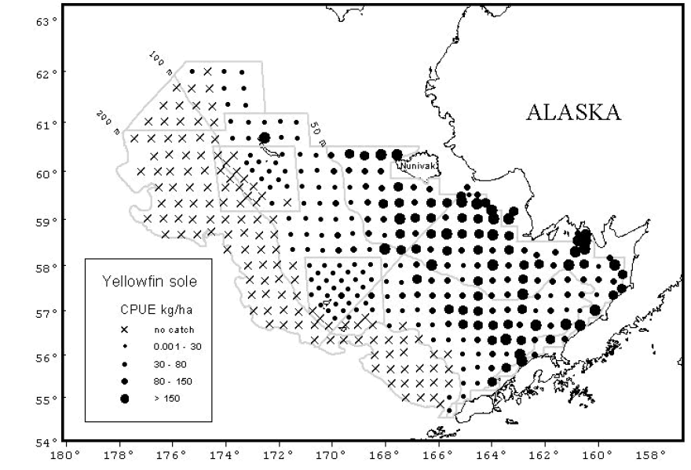
Example: Bering Sea bottom trawl survey
Average count with error bars
for each year of survey
Count fish at 100s
of locations each year
Comparable bottom trawl surveys in Northeast, Gulf of Alaska, Pacific Coast, Gulf of Mexico provide data for assessment of many stocks
Other survey methods provide data for additional stocks
Notes:
Yellowfin sole abundance measured at numerous sampling stations…abundance averaged over time with error because abundance varies across stations
Different techniques required for different habitats

Slide 12
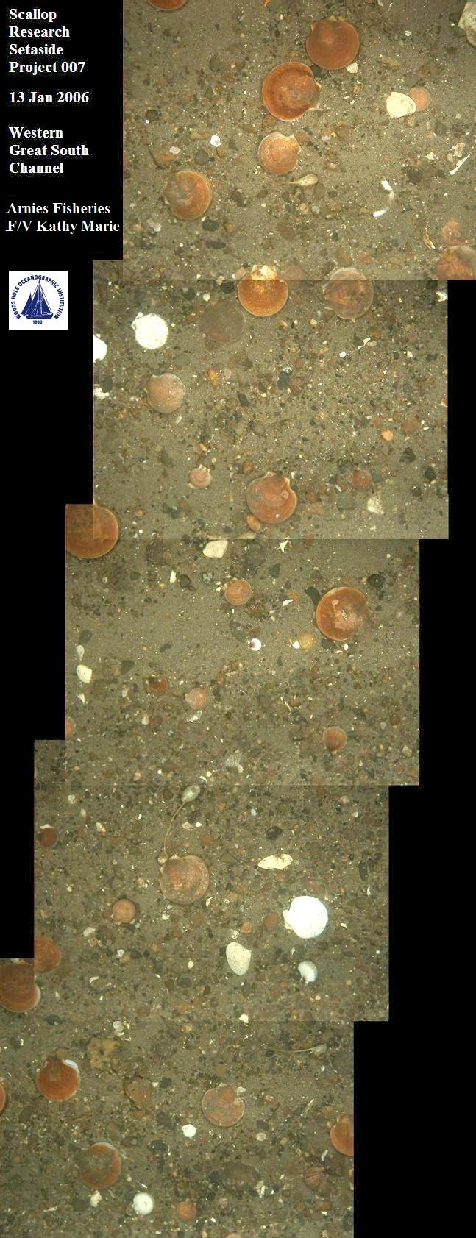
Advanced Technology
Optical surveys for non-lethal absolute abundance estimates
Northeast Scallop Survey now using towed camera system with automated optical recognition software for abundance estimates
Towed and robotic systems being tested for reef-fish surveys in GOM, west coast, Pacific Islands and elsewhere
Scallops
Notes:
AST is invested in developing automated optical recognition software for improving processing efficiency required for next generation surveys.
The ‘next generation’ NE optical scallop survey will be fully implemented in FY12.
This is a good example of AST funded projects that eventually become fully implemented ‘next generation’ surveys to improve stock assessments.
Extra time required to process images, so automating this process is being considered

Slide 13
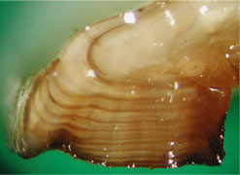
Fish Biology and Life History
Age, length, weight, maturity, fecundity, natural mortality
Otolith (ear bone) with annual marks
Notes:
Range of fish biology is broad…diverse characteristics that need to be considered when determining harvest control rules
Pacific ocean perch mature at age 10 years
Atlantic cod at age 2 or 3
Black sea bass are female when young, then change to male by age 7, so fish too hard and get no males

Slide 14
Quiz Time!!! Which of these is NOT a Critical Assessment Data Component?
1. Catch
2. Environmental data
3. Abundance survey
4. Fish Biology
#2 is the correct answer. Environmental factors affect fish stocks, but we lack enough information to directly include in assessments
Notes:
Environment is key factor, but measuring these effects can be difficult.
We measure the consequences of the change, but often cannot predict how environmental changes will affect the stock

Slide 15
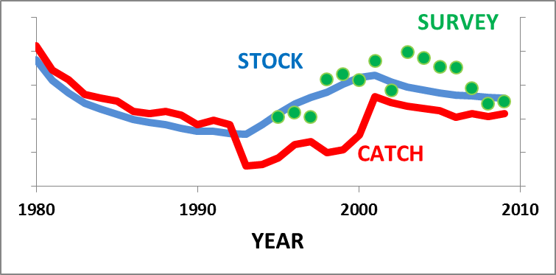
What is a Stock Assessment?
Births
Catch
Environ-ment
Fish Stock
Growth
Predation +
Eco-system
Notes:
Mathematics are used to develop models of fish stock dynamics
Statistics are used to estimate the demographic parameters of the model and determine effects of historical fishing
The model is used to forecast future stock dynamics and identify harvest levels that are sustainable
Statistical estimation and forecasting are complex processes that require highly specialized experts
Stock assessments are not surveys, but data from surveys and catch monitoring are necessary to conduct assessments
Input: catch & relative abundance over time
How large must the population have been,
in order to have exhibited the observed trend in relative abundance over time,
while the observed amount of catch was removed?
If observed decline was steep, then catch must have removed a large fraction of the stock. So stock is small and fishing mortality is high.
Contrast helps calibrate population model

Slide 16

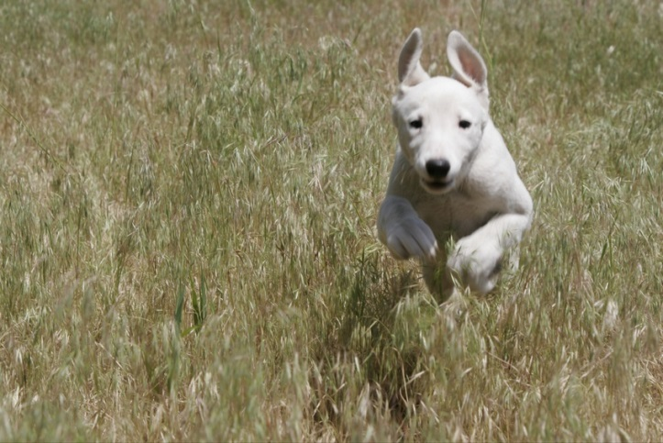

Start with Example Close to Home
Notes:
What is the scientific basis for sustainable harvest of fisheries?
Let’s start with an example closer to home.
At the right is a fallow meadow. No mowing, tall grass, no clippings, happy ecosystem
At the left is a putting green. Lots of mowing effort, not much grass, not much clippings.
At the middle is my lawn. Mowed weekly. Lots of clippings. Nicely managed system. Sustainably harvesting each week’s production.

Slide 17
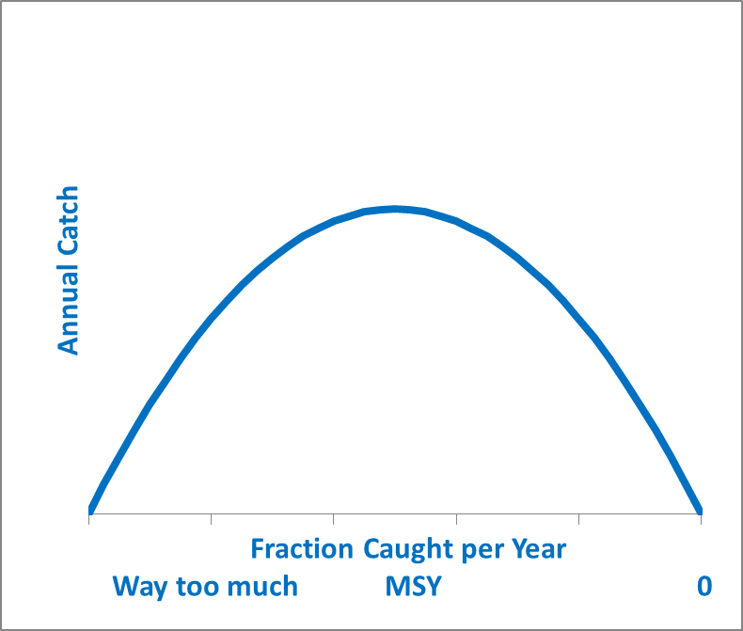
Switch to Fish and Fishing
Lower effort needed
Higher catch rates
Less fluctuations
Larger fish
Less ecosystem impact
Buffer uncertainty
MSY
Pretty Good Yield
Notes:
Now let’s switch to fish and fishing.
Less fishing on the right produces not much catch and allows the stock to retain a larger fraction of large/old fish
Periennial overfishing on the left also produces little catch, but from a small stock with great reductions in larger/older fish
CLICK
An intermediate level of fishing effort can produce Maximum Sustainable Yield from a sustainable stock
Stock assessments calibrate the BLUE production curve and figure out what fraction is currently being caught
CLICK
MSY is useful theoretical limit, but not realistically attainable
This, of course, is a highly simplified cartoon of how actual system’s work, but it basically the same as the lawn example
Scale and shape vary between species and with ecosystem/climate shifts
Instead, aiming for a pretty good yield from a slightly lower rate of harvest produces several benefits as shown in the quote box

Slide 18
Fishery Production Concepts
Notes:
Let’s take a different view of this fishery production curve, now with the X-axis as biomass instead of average fishing mortality
If we are on the right at high biomass and catch more than the blue production curve, we’ll reduce the stock towards the size that can support MSY
But if catch stays above the curve it will continue to reduce the stock towards an overfished state on the left.
Catch below the curve allows for biomass growth
Catch on the curve will stabilize the stock near that level of abundance, but natural fluctuations are inevitable

Slide 19
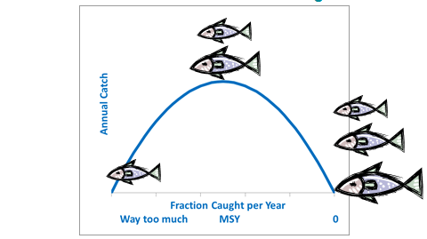
How Hard Can We Fish?
Short-lived shrimp, anchovy, salmon can support high rates
Long-lived rockfish and sharks get MSY at single-digit rates
Over 95% of many rockfish are allowed to “escape” the fishery each year when sustainably fished
A fish’s natural mortality rate and other biology sets scale for how much “interest” can be skimmed off each year sustainably
Notes:
How hard we fish is basically the fraction of the stock caught per year. Call it the fishing rate
The sustainable rate depends on the biology of the stock
Species with different life histories can support greatly different levels of fishing rates
This is why the bycatch of long-lived or otherwise unproductive species can limit the fishing rate on fisheries for stocks with high productivity

Slide 20
Production Model - Reality
Calculating the shape and level of the production curve is difficult:
Real populations show much natural fluctuation
Real data have sampling error
Lack of contrast: stock may not have been observed over full range of biomass levels
The “biomass” is not actually biomass: index treated as proportional to biomass
Adding age data will help pin down the scaling
CATCH
0
STOCK BIOMASS
K
Notes:
The information available guides how well we can understand stock production
If there haven’t been catch measurements across various stock biomass levels, there isn’t much contrast in the data and it’s difficult to estimate the productivity curve
Age data is particularly helpful, because it provides more information

Slide 21
Direct Fishing Effects on Numbers at Age
As fish age, they tend to die off at a consistent, natural mortality rate
With fishing, the total mortality rate increases so:
Fewer old/large fish
Smaller mean body size
Shorter generation time
Adding age data provides more information about the effect of fishing
Notes:
Numbers at age with and without fishing
The difference helps us understand effects of fishing

Slide 22
Age-Structured Data Provide Details
Higher F: faster die-off
Gear regulations: reduced catch of young fish
Bubble size is amount of catch at age (column), year (row)
Catch of youngest fish is lower because they are too small to be selected by fishery
Notes:
Complicated! But illustrates the added information obtained by collecting data on ages of fish in the catch and surveys
Understanding catches by age over time greatly helps understand effects of fishing

Slide 23
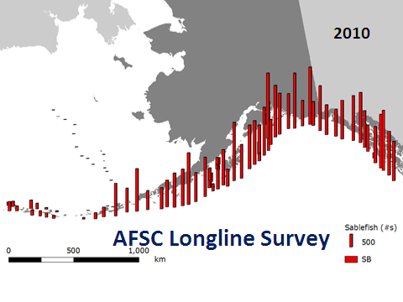
Sablefish Assessment in Gulf of Alaska
Abundance
Notes:
Several surveys of sablefish provide relative indices.
Not all surveys show exactly the same trends, adding to uncertainty
Catch tracking predates surveys
Stock biomass has wider confidence intervals during years without surveys…also can forecast future biomass, but without data uncertainty increases

Slide 24
Assessment Outcomes: Status Determinations
Notes:
Now that we have estimate of Fmsy and Bmsy, we can look at current F and B relative to these levels. This is the status determination for overfishing.
We also seek to answer management questions such as:
What harvest strategy would maximize long-term benefits while protecting marine ecosystem?
What harvest strategy will allow overfished stocks to rebuild to target abundance level?
What level of catch next year would correspond to the target harvest policy (or rebuilding plan) and have acceptably low chance of causing overfishing?

Slide 25
Status of 130 Assessed Stocks
MSY

Slide 26
Pro-Active, Short-Term Advice
What level of catch next year would correspond to the target harvest policy?
What level of catch next year has no more than a specified (<=50%) chance of causing overfishing?
Control Rule: Formula that calculates future target catch level from forecast biomass level

Slide 27
Annual Catch Reference Points (per Nat. Std. 1 Guidelines – 2009)
OFL: Overfishing Limit
Long-term average is MSY
ABC: Acceptable Biological Catch
ACL: Annual Catch Limit
ACT: Annual Catch Target (optional)
Increasing catch
ABC accounts for scientific uncertainty in estimating the true OFL
ABC = OFL would imply no scientific uncertainty
ACL = ABC is OK, just the science-management hand-off
ACL is trigger for accountability
ACT = ACL, or no ACT, would imply perfect control of catch
Notes:
Annual catch target accounts for management uncertainty

Slide 28
OFL Control Rules
Now focus on pro-active; using the control rule to prevent overfishing
But, info is never as definitive as implied by this neat figure
Scientific uncertainty
Notes:
Under prevailing ecological and fishery conditions, there is a level of F (MSY control rule) that would produce the maximum long-term average yield (MSY - red circle in Figure 1).
The NS1 Guidelines set this as the upper limit (F_{MFMT}) for the annual F. Fishing at a rate above F_{MFMT} is overfishing because it jeopardizes the capacity of the stock to produce MSY. While fishing at the MSY control rule, the abundance of the stock (biomass) will tend to naturally fluctuate around the B_{msy} level, which is typically near 30-50% of the unfished level of abundance.
Want to not just look back at status over time, but want to recommend levels that will not result in overfishing
Steep line: large fraction caught each year
Ability to implement is not perfect

Slide 29
P*: Chance of Overfishing
SSC is expected to address scientific uncertainty when setting ABC
Curve shows scientific uncertainty in estimate of OFL
True, but unknown, OFL could be higher or lower
P* is chance that true OFL is less than ABC, the targeted catch
Setting ABC < OFL reduces chance that catching this ABC will lead to overfishing
Trade-off: How much catch is foregone to achieve an acceptably low chance of overfishing?
ABC/ACL
OFL
Chance (probability)
P*
Catch
Notes:
Assessment data are never perfect
Assessment models are always approximations of nature
Control of fishery to recommended catch level is also imperfect
So, here we show how uncertainty in the information is used to guide the size of a buffer between the limit and the target
Of course, in very data-poor situations in which we know little more than historical catch, we need to use even rougher approximations to provide guidance.

Slide 30
Annual Catch Reference Points (per Nat. Std. 1 Guidelines – 2009)
OFL: Overfishing Limit
ABC: Acceptable Biological Catch
Example: P* = 40%
Reduce ABC to a level where there is a 40% chance that OFL<ABC
ACL: Annual Catch Limit
ACT: Annual Catch Target (optional)
Increasing catch
Notes:
Annual catch target accounts for management uncertainty

Slide 31
Limit and Target Control Rules
F is the fraction caught
Annual Catch = F times B
Notes:
How control rules guide process
Larger buffer is used when stock is depleted below target biomass

Slide 32
Control Rule Performance
Jump to F_{MSY}; slow rebuild
Year
Notes:
Scenario where we jump to Fmsy when we realize stock is overfished
Back to production model with no recruitment variability
Start in year 0 with stock below Bmsy and with overfishing driving stock lower
Then lets look at various control rules for the future

Slide 33
Control Rule Performance
10 year rebuilding plan
Year

Slide 34
Control Rule Performance
Delay the pain, but still rebuild in 10 years
Year
Notes:
Also called balloon payment

Slide 35
Control Rule Performance
Long-term buffer with 5-year phase in
Several options to consider: socioeconomics can guide selection
Buffer is important, because the real world has uncertainty
Year
Notes:
Overall, several scenarios to consider, and this is where socioeconomic impacts are key to informing which approach is implemented
The buffer is important to account for uncertainty…this example represents a perfect world scenario, but there is always uncertainty

Slide 36
Management Strategy Evaluation
OFL is the annual catch when fishing mortality is at the rate that gives MSY
OFL varies above and below the MSY level depending on fluctuations in abundance.
Over the long term, average OFL close to equilibrium MSY
ABC: Fishing at slightly less than F_{MSY} gets less catch from given abundance level, but higher abundance and similar catch over long-term
Notes:
These 200 year simulations are run as if there was perfect information about abundance and perfect control of the fishery.
All of the fluctuation is just due to random variability in the amount of new recruitment each year
In the real world, there is much more uncertainty and time lags
Management Strategy Evaluation uses a similar simulation approach, but builds in a more realistic representation of what happens in a real situation
Increasingly sophisticated tools available for analyzing scenarios
Stock will fluctuate around the equilibrium conditions…if we can maintain a constant F, catch will fluctuate over time with biomass because productivity is fluctuating, but on average we are near MSY

Slide 37
Data-Poor Situation
Fact: for data-poor stocks, there is a level of catch that would be overfishing and will eventually deplete the stock;
We just don’t know what it is;
Estimate of uncertainty should reduce as we get more info, not get larger as we calculate more components of uncertainty;
So need proxy for unmeasured (likely) uncertainty;
Data-poor approach to management should be at least as conservative as the approach used when a data-weak assessment can be done;
Difficult because we usually have only past catch as an indicator of the situation.
Notes:
Data-poor approaches (ORCS, DBSRA) can be thought of as stop-gap approaches until we have more information to conduct an assessment
Proxies for unmeasured uncertainty can be informed by similar stocks with more complete info
Catch-only approach: how do we set a buffer in this situation? But we’re not accounting for all uncertainty, so the buffer should at least be as conservative as a similar species with more information
Paradox: in a data-poor situation, we don’t know how to calculate uncertainty, so in principal the buffer should be at least as large as when we would calculate uncertainties

Slide 38
Quiz Time!!! When assessments cannot calculate uncertainty, SSCs should set ABC:
1. At the overfishing limit, OFL
2. Below the OFL using uncertainty proxy from other stocks
3. Refuse to set an ABC
#2 is the correct answer. They are expected to do the best they can to account for scientific uncertainty.
Notes:
Need to account for science uncertainty, even if they have to borrow information from other stocks…this is their role to inform the Councils

Slide 39
Summary
Assessments are designed to answer management questions
Catch, abundance patterns, biology are key inputs
Variety of advanced technical methods tuned to diverse data availability scenarios
Assessments produce estimates of stock abundance, fishing mortality, and productivity
Stock forecasts provide technical basis for guiding the level of Annual Catch Limits

Slide 40
For More Information
NMFS stock assessment site
http://www.st.nmfs.noaa.gov/stock-assessment/index
FishWatch
http://www.nmfs.noaa.gov/fishwatch/
Status of Fisheries and FSSI Quarterly Reports
http://www.nmfs.noaa.gov/sfa/statusoffisheries/SOSmain.htm
Species Information System for stock assessment and status determination data
https://www.st.nmfs.noaa.gov/sisPortal/sisPortalMain.jsp
Notes:
More info on stock assessments and how well US stocks are being managed

Slide 41
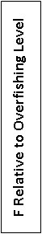
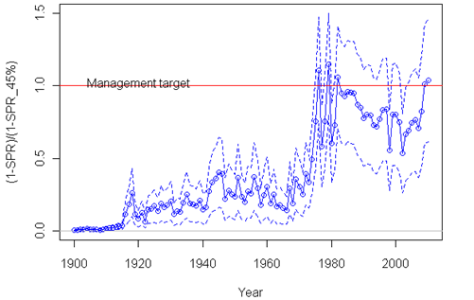
Group Exercise
Set P* - the chance of overfishing for a stock
A: Set P*=49%; ABC would decline just 2% while tracking decline in stock
B: Set P*=40%; short-term ABC would decline 20%, then begin to increase after 3 years
Notes:
Hand out – 10 minutes or so to read through – have each table respond to the questions
Goal: consider tradeoffs
New assessment has much uncertainty
Indicates stock as been declining
Now approaching both overfishing and overfished levels

Slide 42
BACK-UP SLIDES

Slide 43
What does it mean to prevent overfishing?
Intentional overfishing; i.e. setting a target that is beyond the best estimate of the overfishing limit. In principal, the US has ended this type of overfishing.
Management shortcoming: this occurs when fishery management procedures fail to keep the catch below the overfishing limit. This could be accidental (procedures were in place but they didn't work), or structural (no credible accountability measures were in place to keep catch under control within the fishing season).
Science uncertainty: this leads to retrospective revision of calculated historical abundance and fishing mortality such that the revised historical level now appears to have exceeded the limit, even though the catch was not over the ACL. This may happen every few years as major updates of assessments occur.
Ecosystem overfishing: this occurs when the model/paradigm under which the tactical estimates of overfishing limits are calculated is wrong/biased/inadequate. We may not find out about this until decades later.

Slide 44
How/When is overfishing measured?
Catch compared to OFL
Can be done each year, no new assessment needed
High transparency for public, consistent with the ACL paradigm
Forecast of ACL and OFL from past assessment does not account for recent recruitments, so need frequent assessment updates to keep ACL and OFL current
Overfishing determination is only sensitive to management uncertainty
Subsequent estimation of F by assessments does not result in overfishing determination
F compared to Flimit
Requires assessment to calculate current F and update Flimit
Low transparency for public, keeping catch < ACL does not mean that new estimate of F will be < Flimit
Because this is a hindcast, it is not sensitive to recent recruitments, but associated ACLs are sensitive
Overfishing determination could be caused by management uncertainty or scientific uncertainty

